Slide 1




presents
team details:
Data RIDERS
Varad gandhI Rohit BHATIA
datathon
2.0
Where Data Science transforms Ideas into impact

Slide 2
Problem Statement:
Image processing has been an innovative paradigm of the generation wherein identifying the individual entities accurately has been the major aim. Our code intends to solve this problem using 2 pieces of different ideologies, one being identification of vegetables from the images and then counting the number of entities in the image. Our solution aims to be a perfect blend to create new algorithm for creating an amalgamation of separate coding philosophies

Slide 3
Proposed Solution:
To come up with a solution for delivering the best prediction algorithm for identification of vegetables from the images.
Coming up with a separate system for identifying and counting the number of items in a particular image to the best possible accuracy (removing the noise)
Filtering out the information to get an exact idea of the vegetables and their quantity.
Making an estimate about the weights from the above factors deciphered from the image.

Slide 4
Differentiating factor:
Many of the solutions out there do only work out for identification of objects through images or separately identifying the count of objects. A system doesn’t exist which creates an actual amalgamation of the two different solutions in order to give an exact idea about the weight of the vegetable basket. Our solutions aims to fill in the gap just by creating a streamlined algorithm for the same.

Slide 5
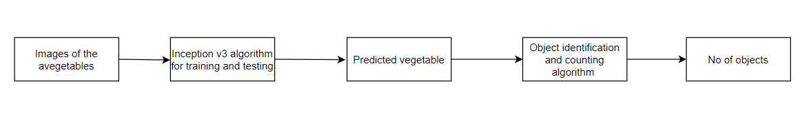
Process Flowchart:
The application proposed has 2 important parts, one the inception v3 algorithm for training and testing for image classification and the object counting algorithm in Python-

Slide 6
Inception v3 algorithm:
The code is developed using deep learning methodologies for identification of the vegetables from the images-
Inception v3 is a convolutional neural network (CNN) architecture that was developed by Google as part of the Inception architecture series. It was designed for image classification and recognition tasks.
Important points about Inception v3 –
Inception v3 is based on the idea of using "inception modules," which are blocks containing multiple parallel convolutional operations.
It employs a combination of 1x1, 3x3, and 5x5 convolutions, along with pooling operations, in parallel within these modules.
The algorithm overall gives out a complete accurate package for identifying the vegetable in the image.

Slide 7
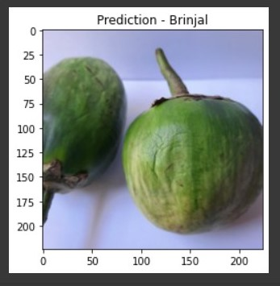
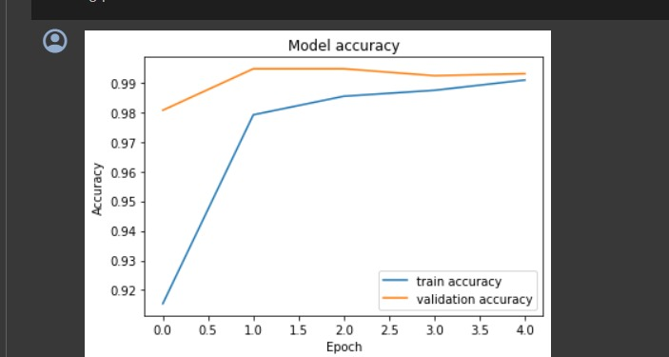
Application in Action:
The code developed yields the following outputs for image classification -
The algorithm works well on the validation dataset yielding better accuracy
Prediction works accurately on the set of image

Slide 8
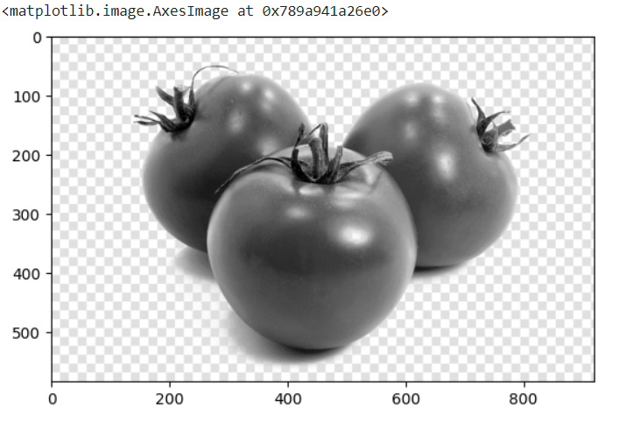
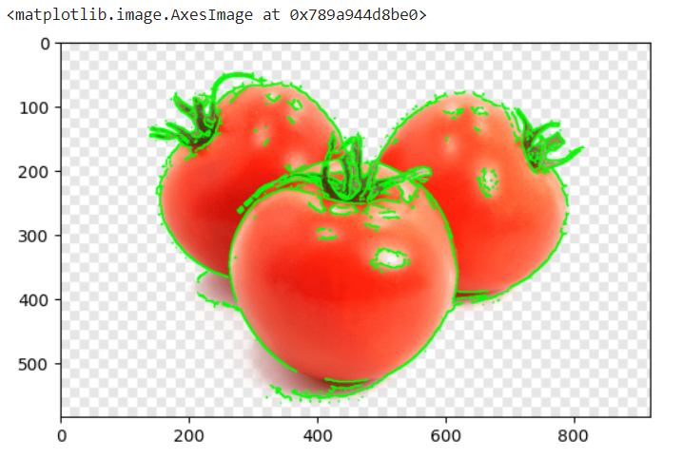
Application in Action:
The code developed yields the following outputs for image classification -
The algorithm takes in a black and white image of the vegetable
Detection of edges for the images is accurately performed.

Slide 9
Thankyou

